Slide 1
Data Science Internship
-by: Arnab Adhikary
OASIS INFOBYTE

Slide 2
Task->1

Slide 3
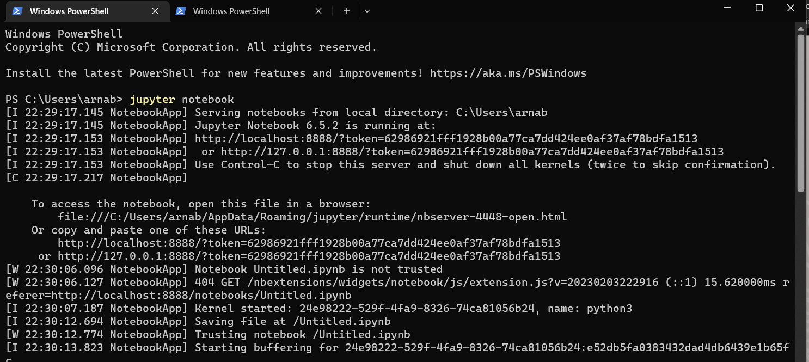

Slide 4
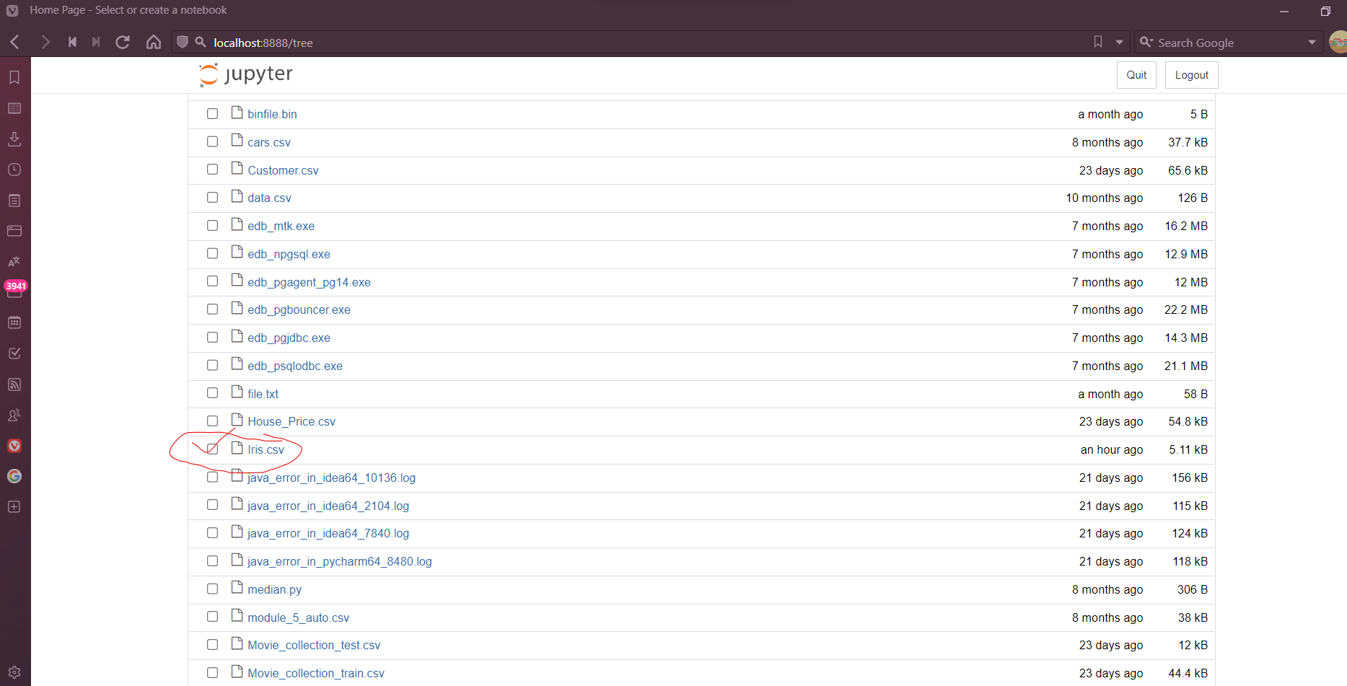

Slide 5
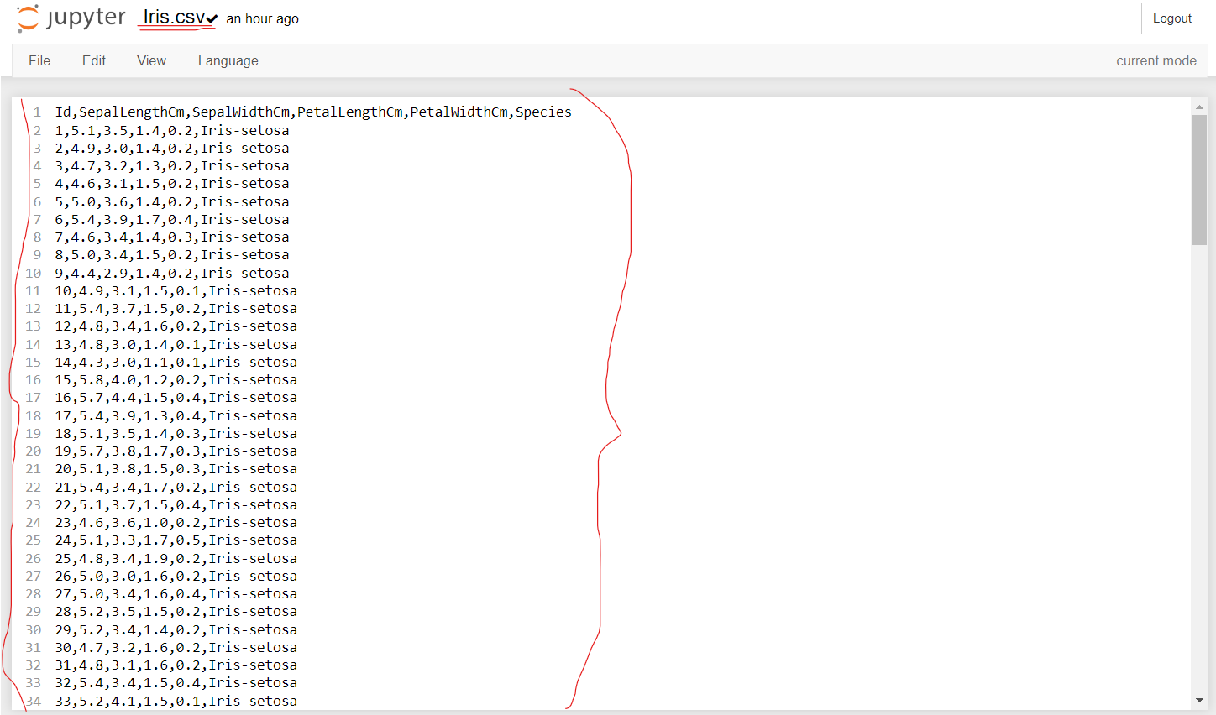

Slide 6
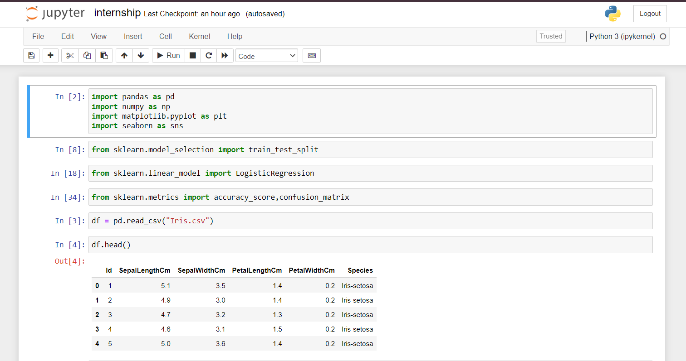

Slide 7
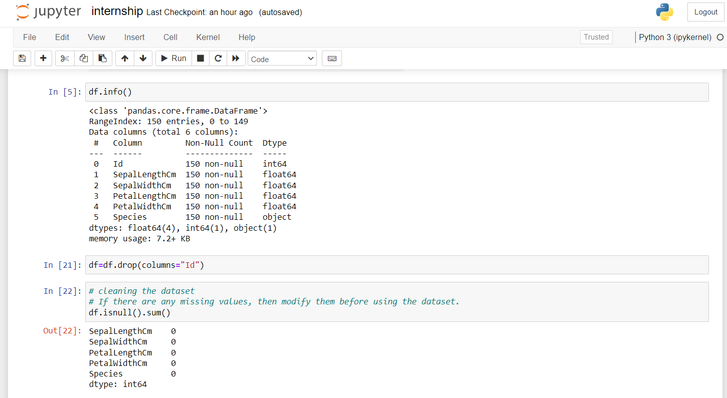

Slide 8
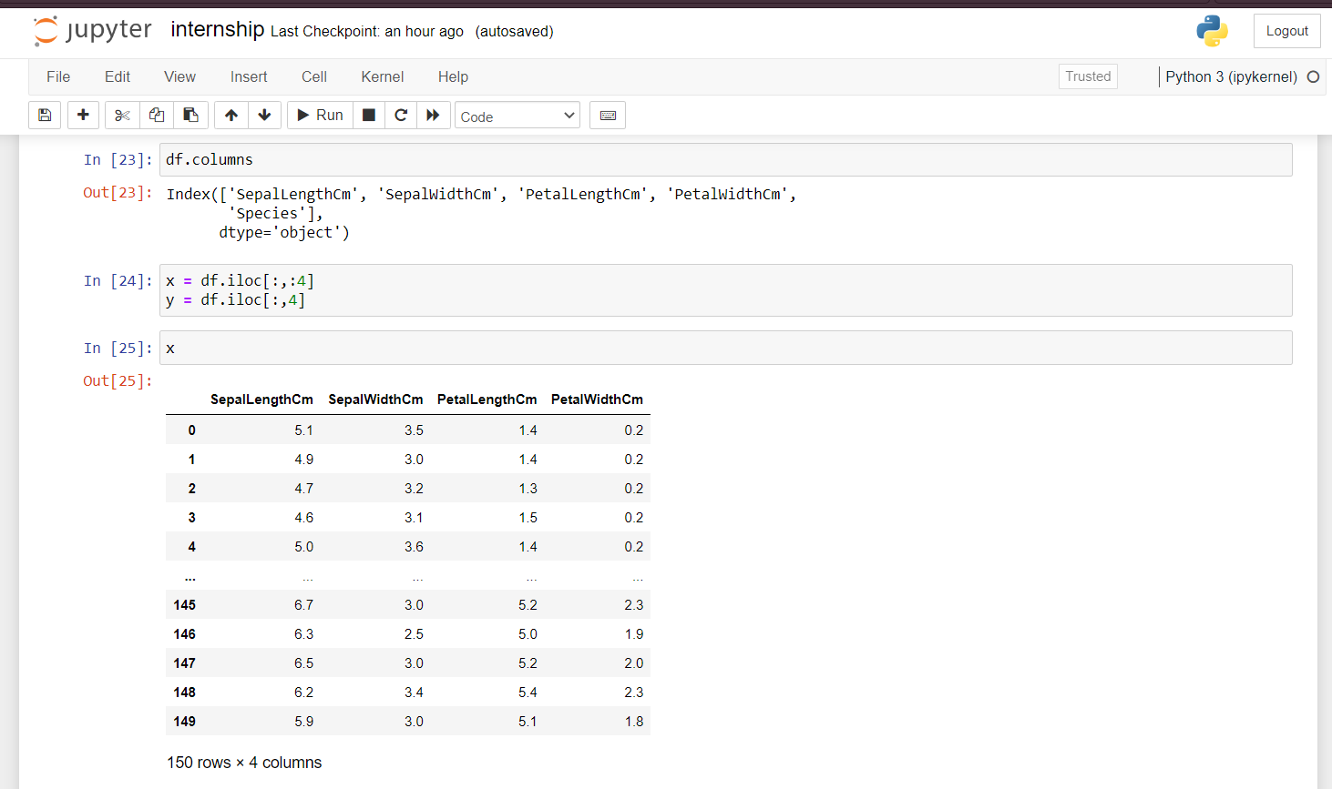

Slide 9
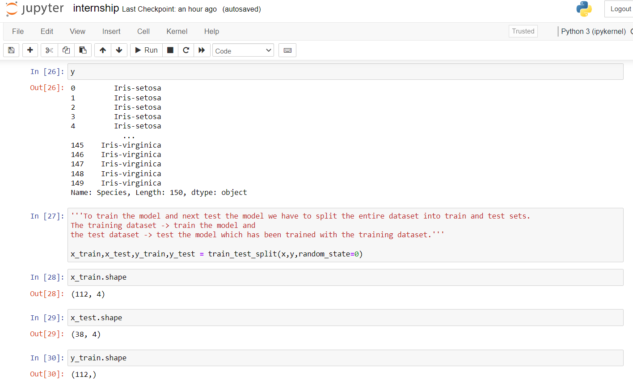

Slide 10
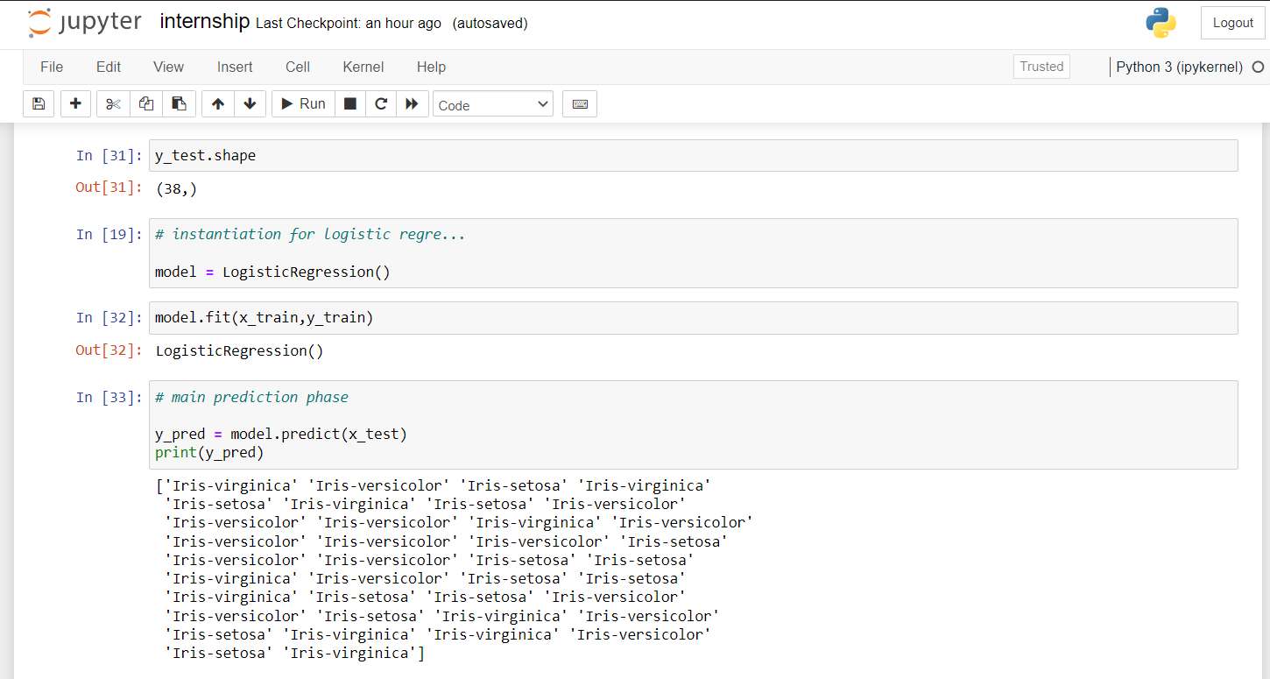

Slide 11


Slide 12
So, why are we waiting for, Let’s Execute it !!!

